Slide 1
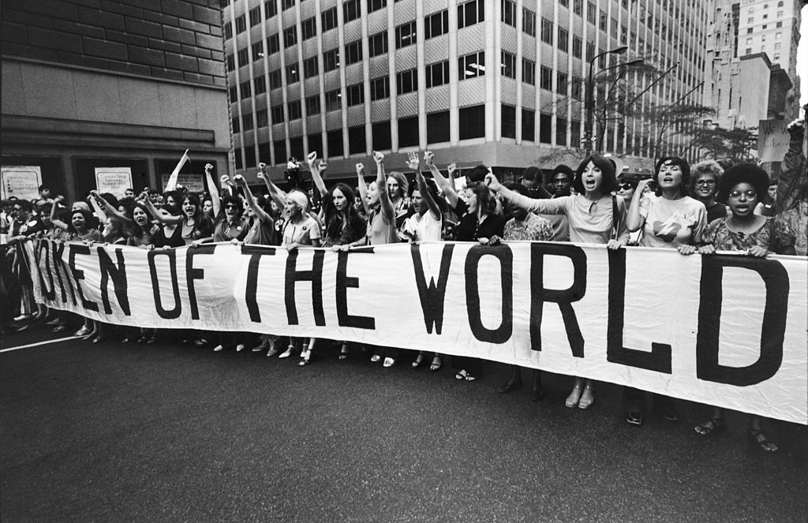
Gender Inequality in the Workplace
Ömer Cem Tabar - 2081169
Anıl Özfırat - 2087154
İsmail Deha Köse - 2072544
Zafer Çınar - 2041428
Network Science Project
Tomaso Erseghe

Slide 2

Outline
How does gender inequality manifest in the workplace, and what contributing factors can be identified through a case study analysis, aiming to understand the challenges and dynamics surrounding this issue?
Outline
Motivation
Data Collection
Data Processing
Community Detection
Performance Evaluation
Detected Topics
Word Cloud Visualization
Sentiment Analysis
Summary
Conclusion

Slide 3
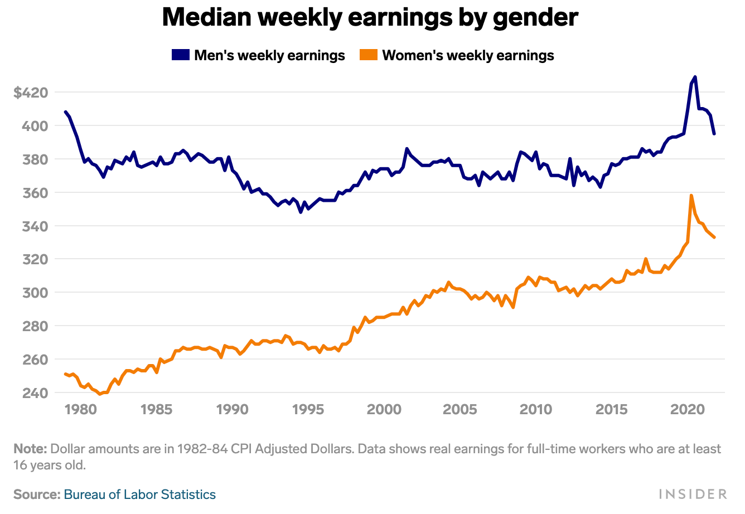
Motivation
Question: Why Does Gender Inequality Matter in the Workplace?
Key Points:
Pervasiveness and urgency of the issue.
Persistence of disparities despite progress.
Ethical and economic implications.
Individual and collective potential stifled by barriers.

Slide 4

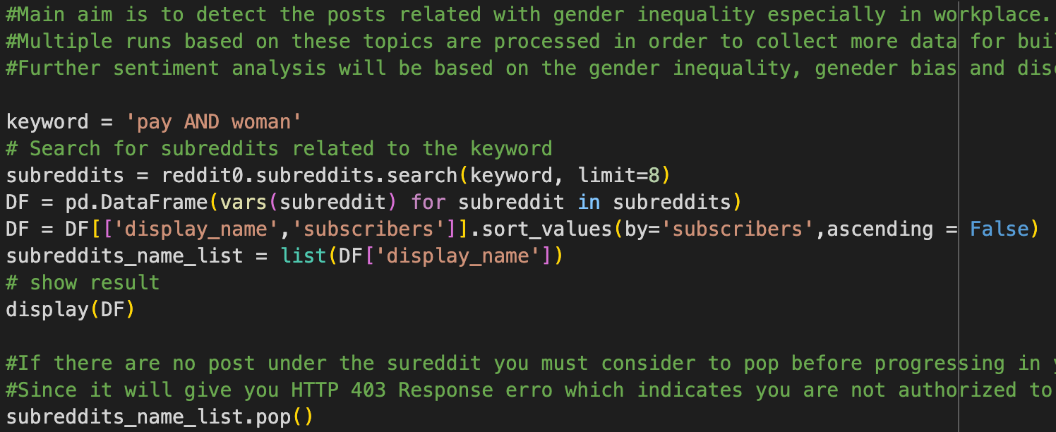
Data Collection
Methods used to collect relevant data (e.g., specific subreddits, keywords).
Timeframe and size of the dataset.
Ethical considerations in data collection.

Slide 5
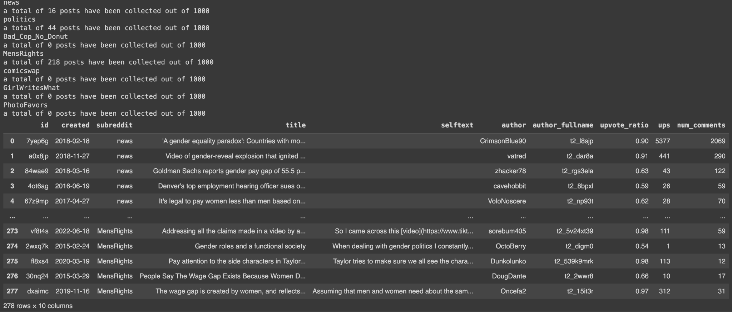

Slide 6
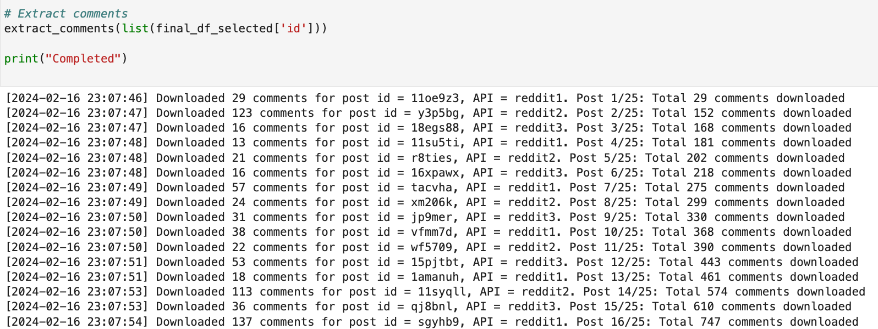

Slide 7

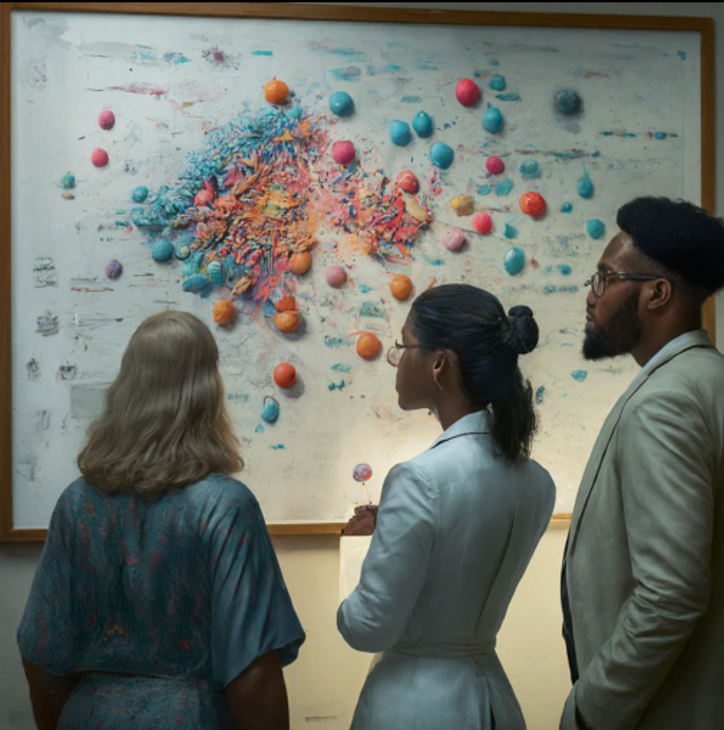
Community Detection
Identifying groups or communities within the data based on shared characteristics.
Methods used for community detection (e.g., clustering algorithms).
Insights gained from analyzing distinct communities.

Slide 8
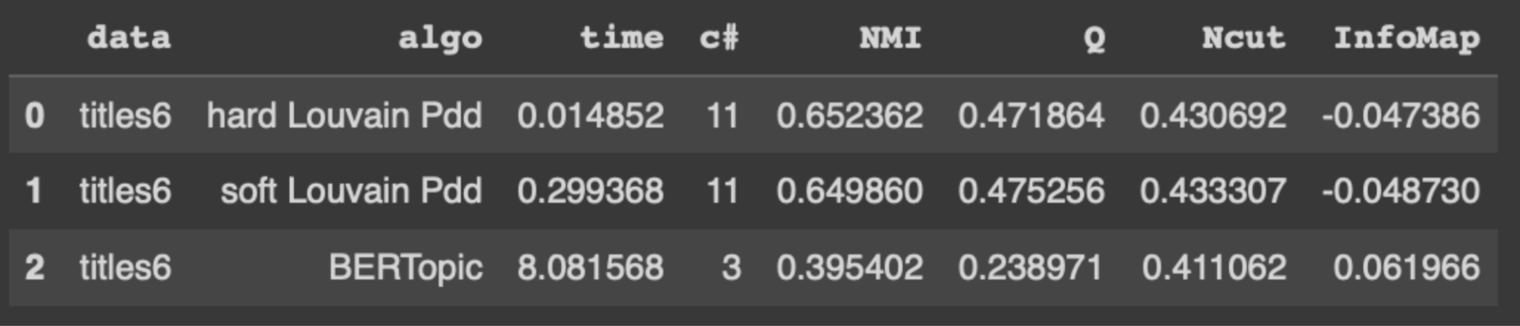
Performance Evaluation
Metrics used to assess the effectiveness of data processing and analysis.
Discussion of challenges and limitations encountered.
Steps taken to ensure the robustness of findings.

Slide 9

Detected Topics
Question: What Did We Find?
Description:
Key themes and topics extracted from the analyzed data.
Visual representation of recurring topics (e.g., word cloud).
Connection between topics and understanding of gender inequality.
Hard Louvain Soft Louvain BERTopic

Slide 10
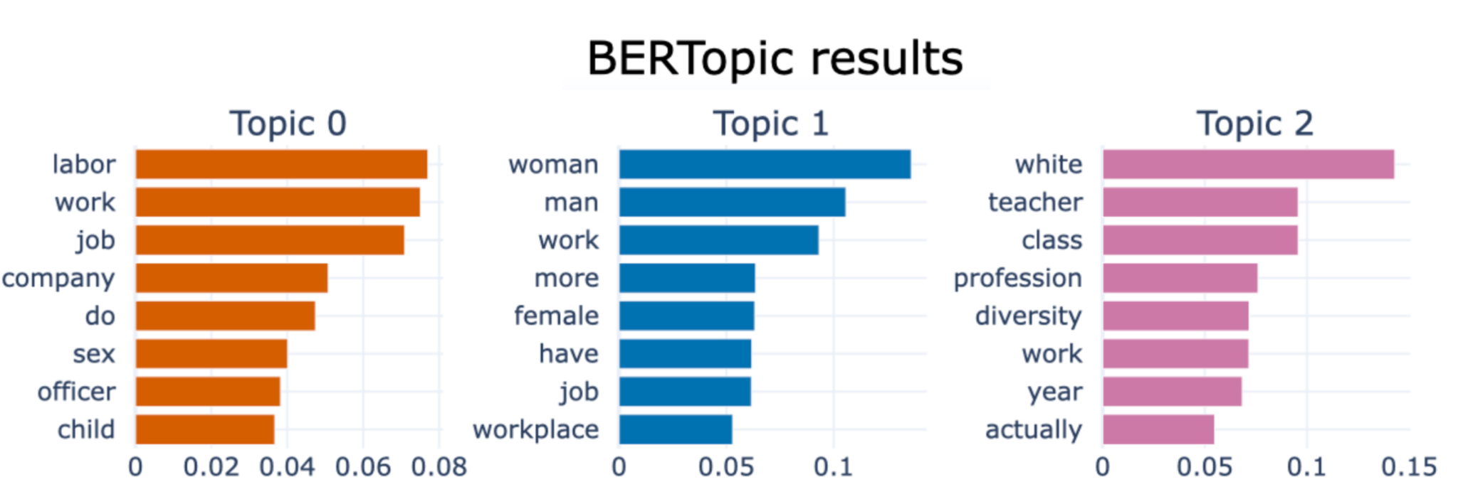

Slide 11
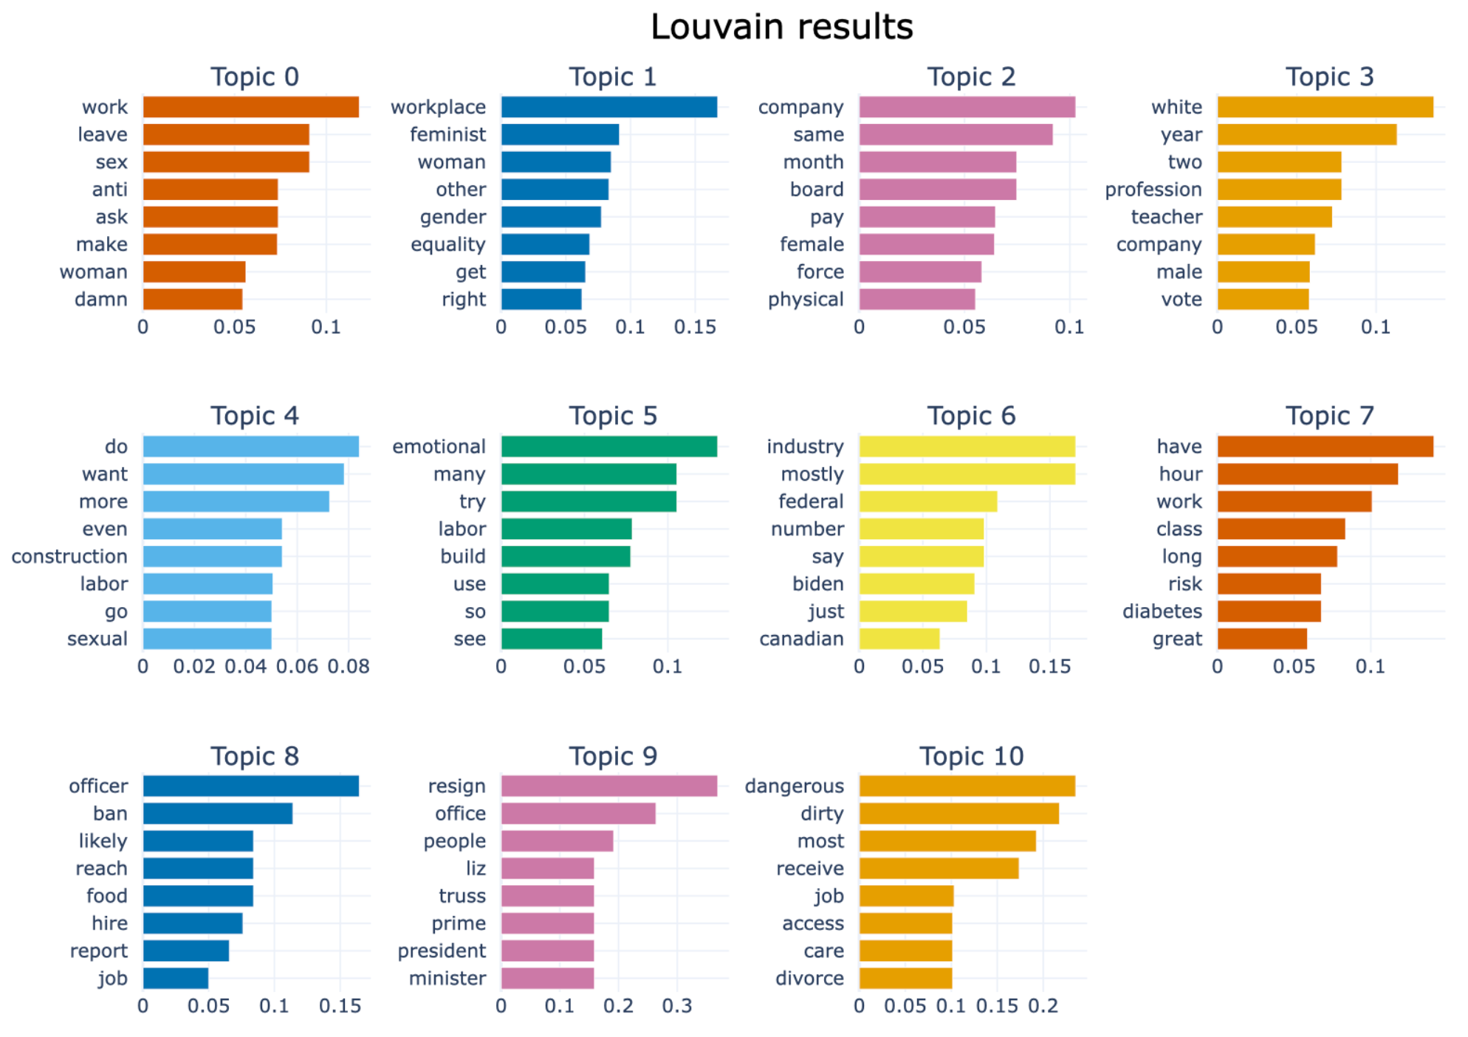

Slide 12
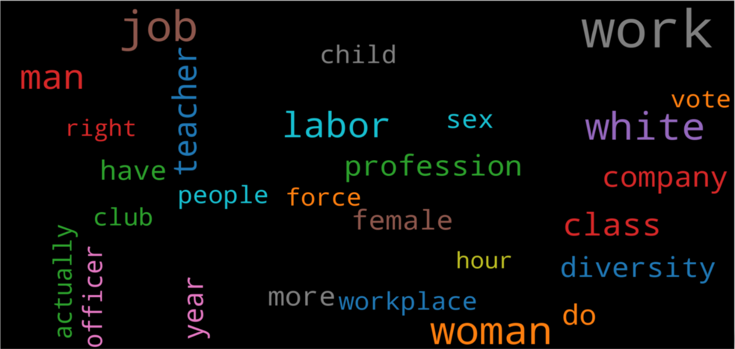
Word Cloud Visualization
BERTopic
Word cloud representation of frequently used words or phrases.
Visual highlighting of dominant themes and trends.
Enhanced understanding of shared experiences and concerns.

Slide 13
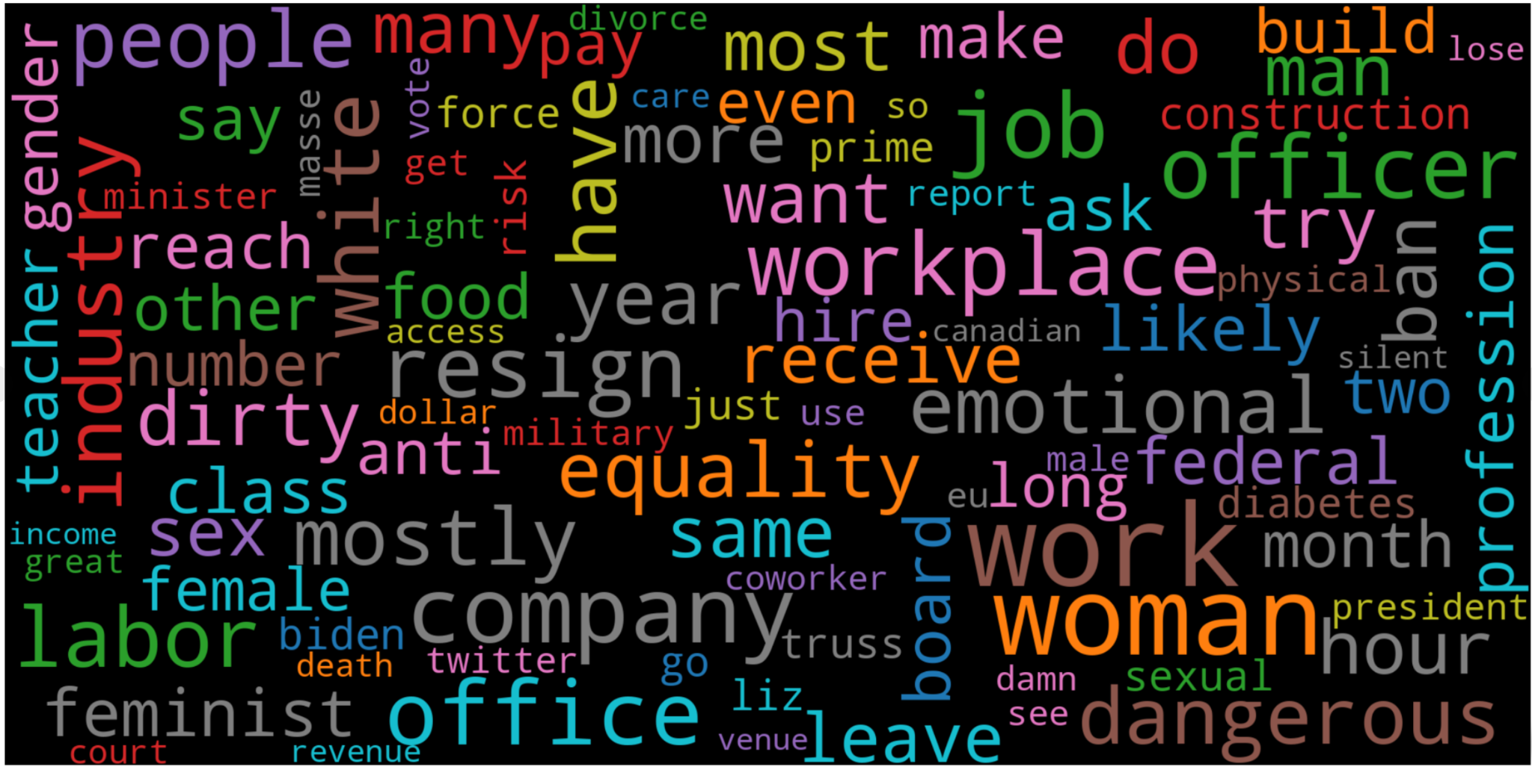
Louvain

Slide 14
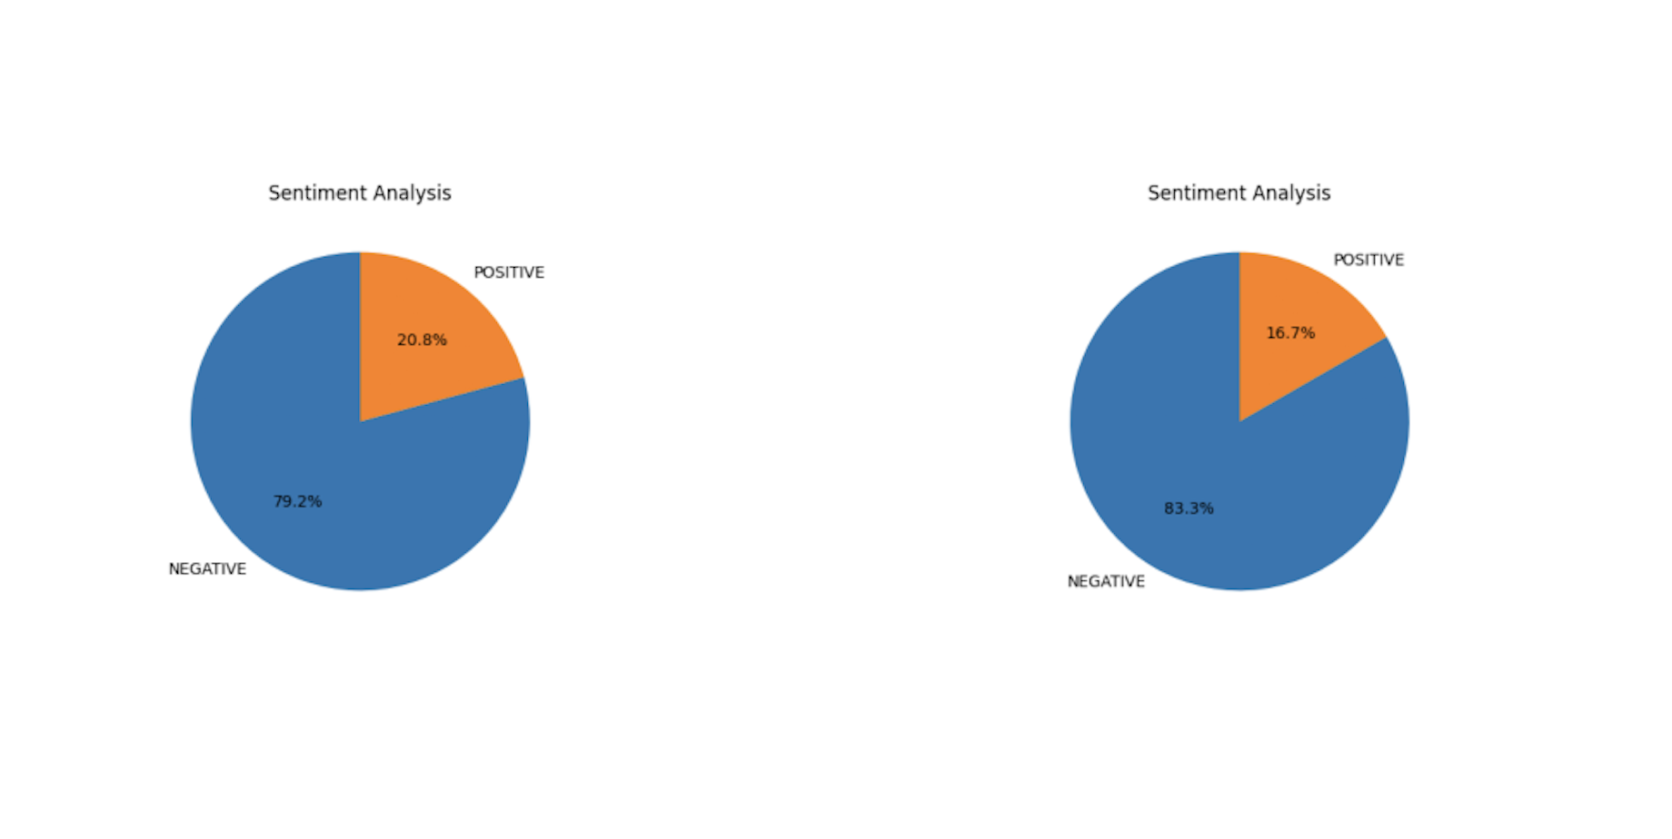
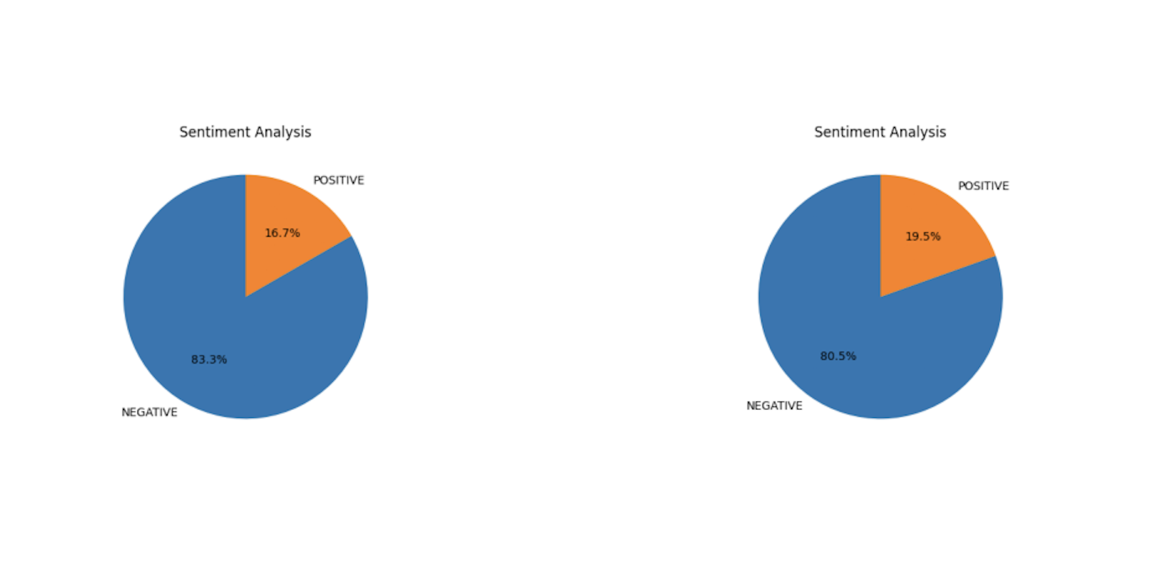
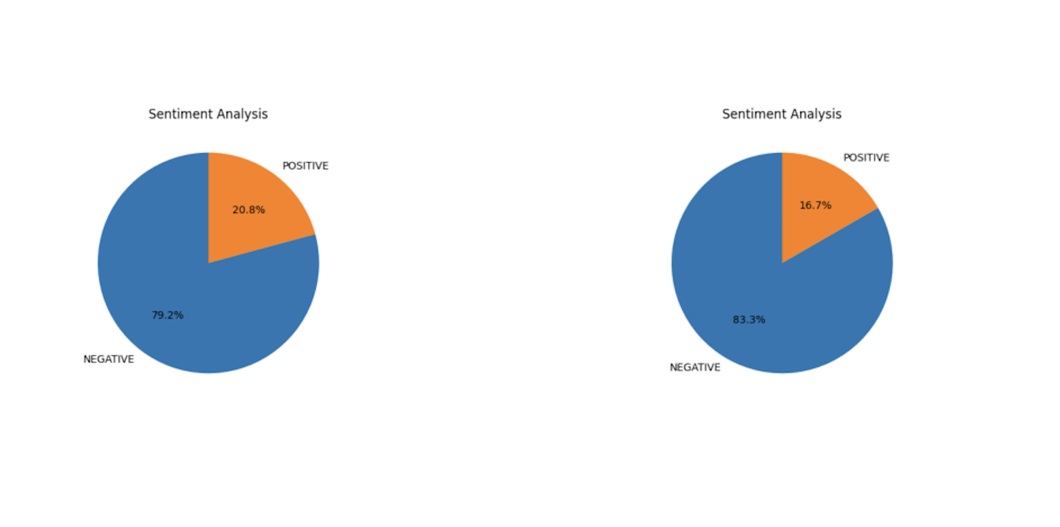
Sentiment Analysis
Title: Feeling the Pulse: Analyzing Emotions and Opinions
Description:
Techniques used to assess sentiment and emotional tone in the data. (HugginFace Pipeline, XLStat, Appbot, MonkeyLearn Sentiment Analyzer)
Distribution of positive, negative, and neutral sentiment across topics.
Connection between sentiment and understanding of lived experiences.
All results are lean on high percentage for negative opinions either applied for titles and comments.
Left: Subreddit(woman & inequality) - Post( job || work || workplace || office || company || industry)
Right: Subreddit(women & inequality) - Post( job || work || workplace || office || company || industry)
Left: Subreddit(female & inequality) - Post( job || work || workplace || office || company || industry)
Right: Subreddit(combined (women || woman || inequality) - Post( job || work || workplace || office || company || industry)
Left: Subreddit(combined (woman || female || inequality) - Post( job || work || workplace || office || company || industry)
Right: Subreddit(combined (women || female || inequality) - Post( job || work || workplace || office || company || industry)

Slide 15
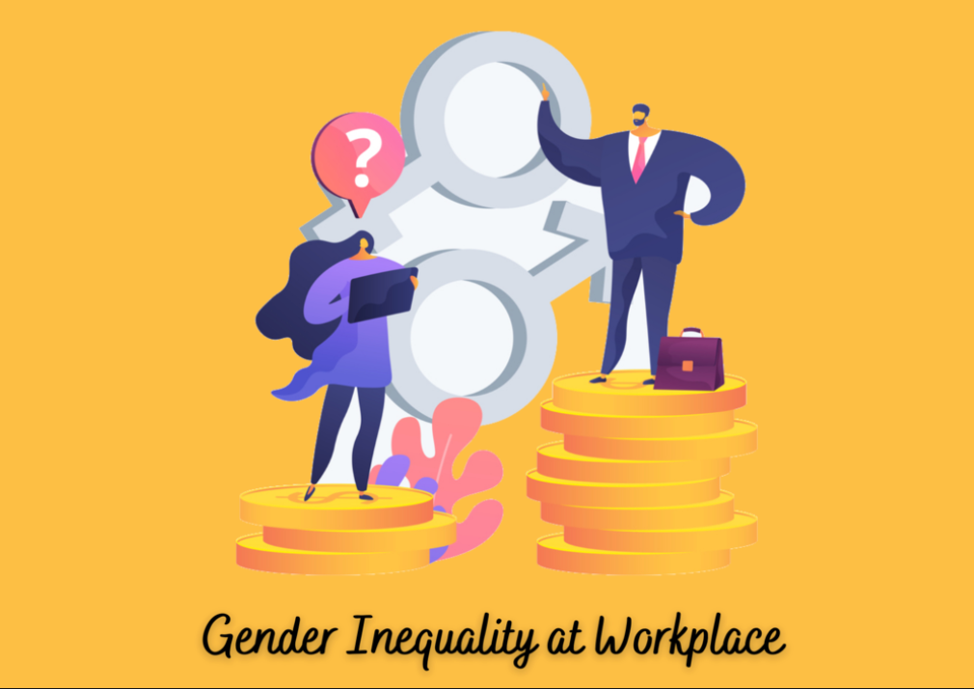
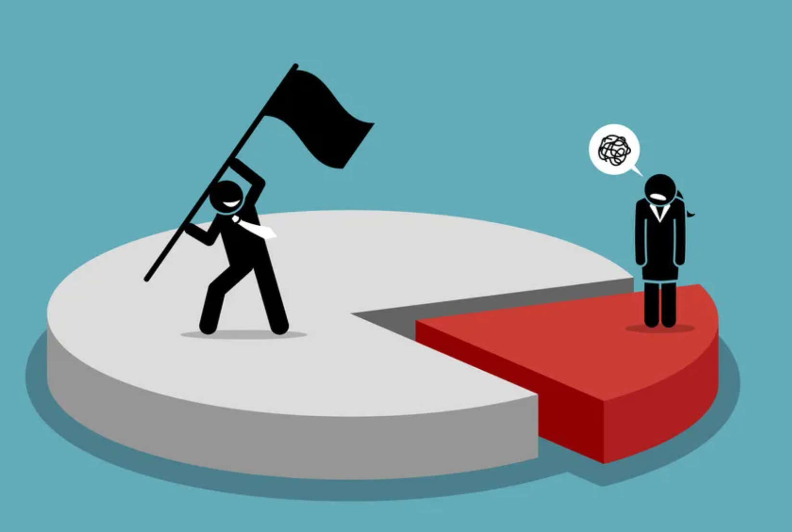
Summary
Topics Covered:
Unequal pay and glass ceilings.
Gender bias and stereotypes.
Challenges faced by women in the workplace.
Occupational segregation and industry gaps.
Workplace discrimination, harassment, and societal expectations.
Role of corporate culture and policies.
Using Reddit data for insights.

Slide 16
Conclusion
Reddit data analysis on gender inequality yielded inconclusive results.
Reddit comments lack clarity and consensus on such complex issues.
Relying solely on Reddit for insights into gender inequality is limited.
Caution is needed when interpreting Reddit discussions on sensitive topics.
Comprehensive understanding requires multiple information sources.
Broader research beyond Reddit is necessary for nuanced insights.
Reddit should be viewed as part of a broader information landscape.
Collaborative research is needed to address biases in online discussions.
Critical thinking is essential when exploring societal challenges like gender inequality.

